Slide 1
Welcome to Javascript

Slide 2
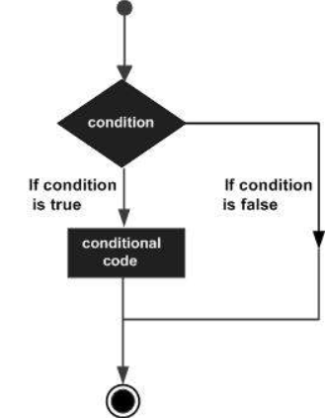
JavaScript conditional statements
JavaScript includes if-else conditional statements to control the program flow, similar to other programming languages.
if condition
if-else condition
else if condition

Slide 3
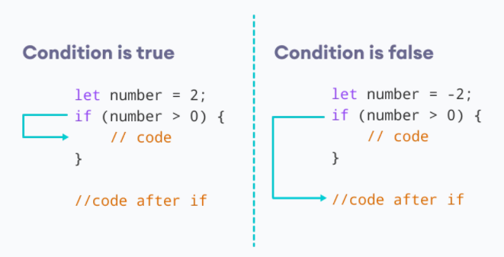
Conditional statements – if condition
The keyword if tells JavaScript to start the conditional statement.
(1 > 0) is the condition to test, which in this case is true — 1 is greater than 0.
The part contained inside curly braces {} is the block of code to run.
Because the condition passes, the variable outcome is assigned the value "if block".
Syntax:
if(condition expression)
{
// code to be executed if condition is true
}
Example:
if( 1 > 0)
{
alert("1 is greater than 0");
}
if( 1 < 0)
{
alert("1 is less than 0");
}

Slide 4
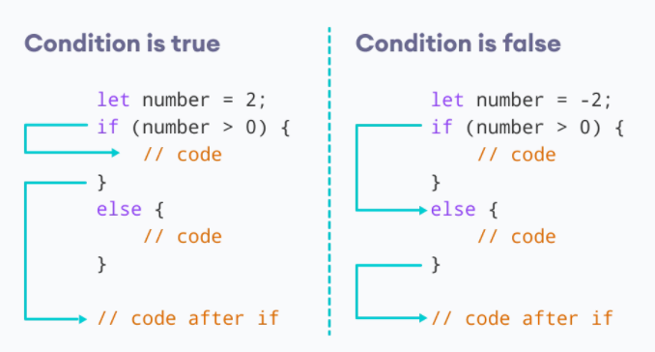
Conditional statements - Else condition
Use else statement when you want to execute the code every time when if condition evaluates to false.
Syntax:
if(condition expression)
{
// block of code to be executed if the condition is true}
else{
// block of code to be executed if the condition is false
}
Example:
let num = 2
// let num = -2
if(number > 0)
{
alert(num +” is greater than 0”);
}
else
{
alert(num +” is less than 0”);
}

Slide 5
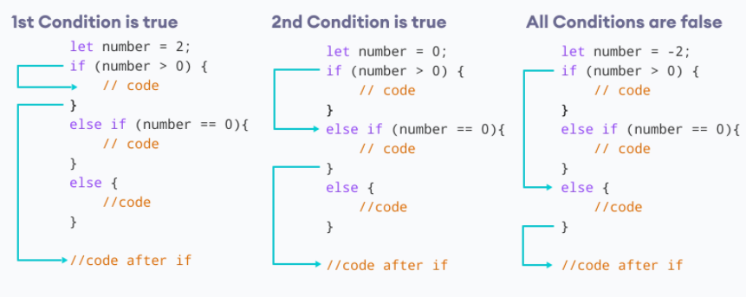
Conditional statements – Else if condition
Use "else if" condition when you want to apply second level condition after if statement
Syntax:
if(condition expression)
{
//Execute this code block
}
else if(condition expression){
//Execute this code block
}
Example:
// check if the number if positive, negative or zero
let number = 2;
number is positive");
} if (number > 0) {
console.log("The
else if (number == 0) {
console.log("The number is 0");
}
else {
console.log("The number is negative");
}

Slide 6
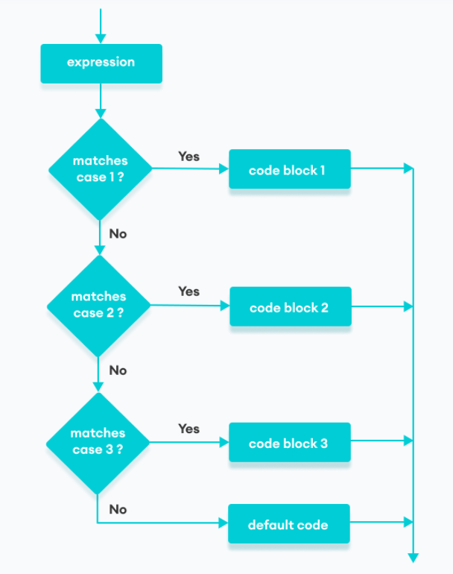
JavaScript conditional statements - Switch
The JavaScript switch statement is used in decision making.
The switch statement evaluates an expression and executes the corresponding body that matches the expression's result.
Syntax:
switch(expression or literal value){
case 1:
//code to be executed
break;
case 2:
//code to be executed
break;
case n:
//code to be executed
break;
default:
//default code to be executed
//if none of the above case executed
}

Slide 7
JavaScript conditional statements - Switch
Example:
let a = 2;
switch (a) {
case 1:
a = 'one';
break;
case 2:
a = 'two';
break;
default:
a = 'not found';
break;
}
console.log(`The value is ‘+{a});
Example:
let str = "bill";
switch (str)
{
case "steve":
alert("This is Steve");
case "bill":
alert("This is Bill");
break;
case "john":
alert("This is John");
break;
default:
alert("Unknown Person");
break;
}

